Slide 1
AI based motion control initial version of collision detection and path replanning
12.10 Jin Lexuan

Slide 2
Future work(slide from last week)
Now is an initial verison, collision point detection part is not finished finished
Two path is set manually now,in the future this method will combine with the path generated from the path planning algorithm
This method will be adjusted to any two path partly finished
After finishing above, it will be applied for more than two UAVs

Slide 3
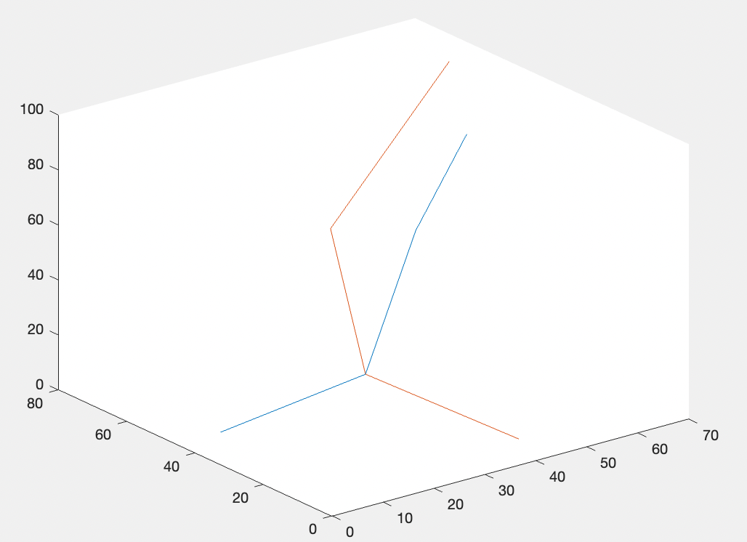
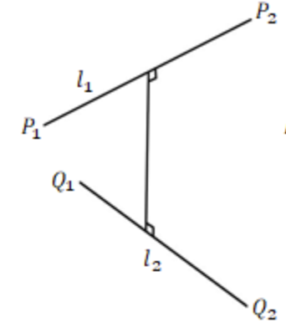
Collision detection for two path:
Input: information of 2 path, radius of collision circle
Output: whether there is collision between 2 path(collision flag)
collision point
steps: 1. path1 and path2 are divided into several segments by ponits,calculate the minimum distance of each segment

Slide 4
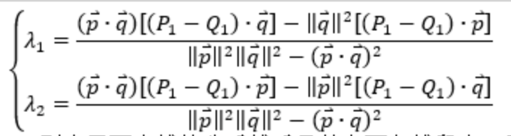

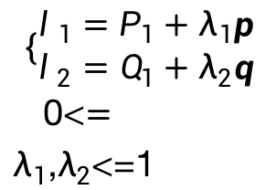


an example for the first step
$$P_{1}(x_{1},y_{1},z_{1})$$
$$P_{2}(x_{2},y_{2},z_{2})$$
$$Q_{1}(x_{3},y_{3},z_{3})$$
$$Q_{2}(x_{4},y_{4},z_{4})$$
vectors:
$$p=P_{2}−P_{1}$$
$$q=Q_{2}−Q_{1}$$
$$\left\{\begin{aligned}l_{1}=P_{1}+λ_{1}p \\ l_{2}=Q_{1}+λ_{2}q\end{aligned}\right.$$
0<$=λ_{1}$,$λ_{2}$<=1
To find the minimum distance can be transformed to the optimization of the formula:
Condition of local minimum

Slide 5
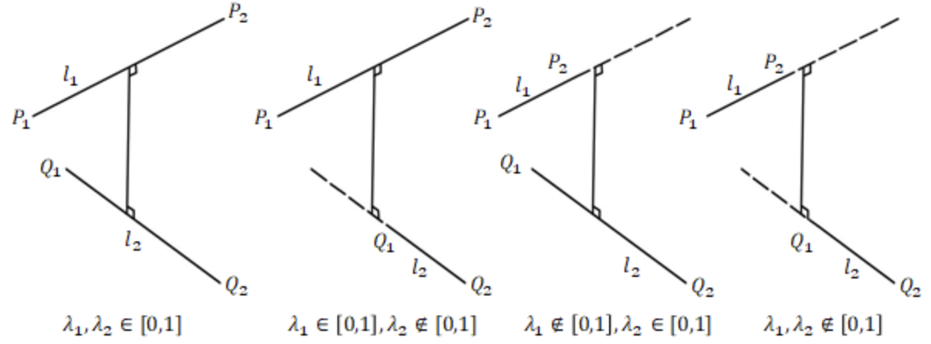



four possible solution of the
for the rest three situation,
means the distance of P1,P2,Q1,Q2 to anothor line respectively
$$d_{min}^{2}=f(λ_{1},λ_{2})$$

Slide 6
Collision detection for two path:
Input: information of 2 path, radius of collision circle
Output: whether there is collision between 2 path(collision flag)
collision point
steps: 1. path1 and path2 are divided into several segments by ponits,calculate the minimum distance of each segment
2. For each segment of path2,
if the minimum distance are larger than the collision circle:
it can be viewed that there is no collision for two path, collision flag=0
else:
there is collision, if the collision point is on the line, record the point.
collision flag=1
3. Combine with the path replanning(mentioned last week),replan path2.

Slide 7
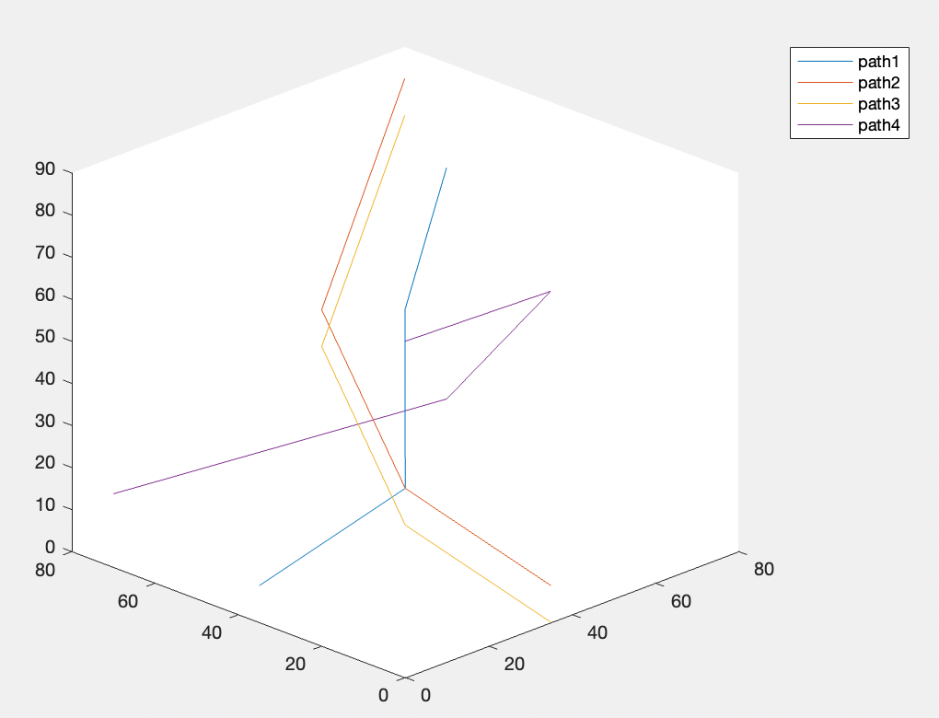
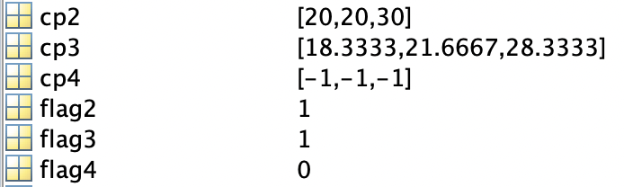
Result of collision point detection

Slide 8
Future work(slide from last week)
Now is an initial verison, collision point detection part is not finished finished
Two path is set manually now,in the future this method will combine with the path generated from the path planning algorithm partly finished
This method will be adjusted to any two path
After finishing above, it will be applied for more than two UAVs

